Slide 1
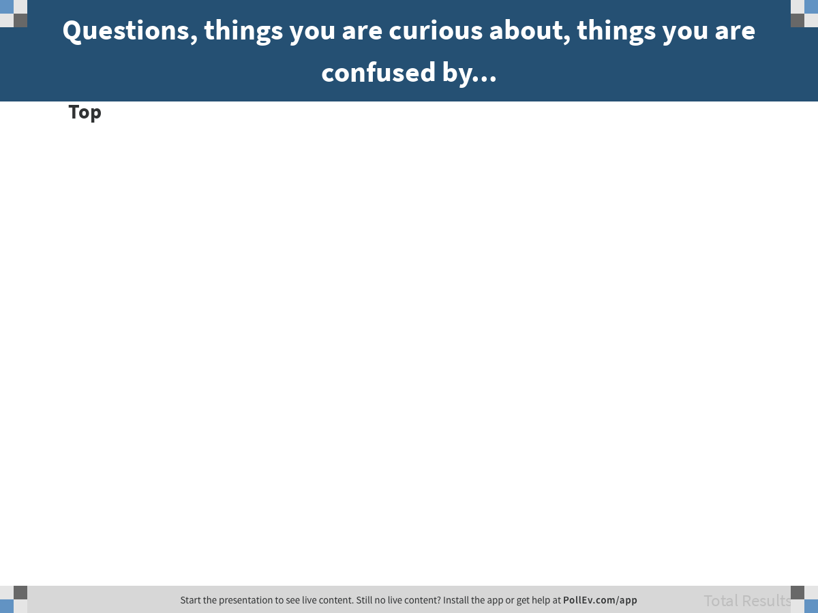
Notes:
Questions, things you are curious about, things you are confused by...
https://www.polleverywhere.com/discourses/GWUgNUeQF1LZJWzt2GVu7

Slide 2
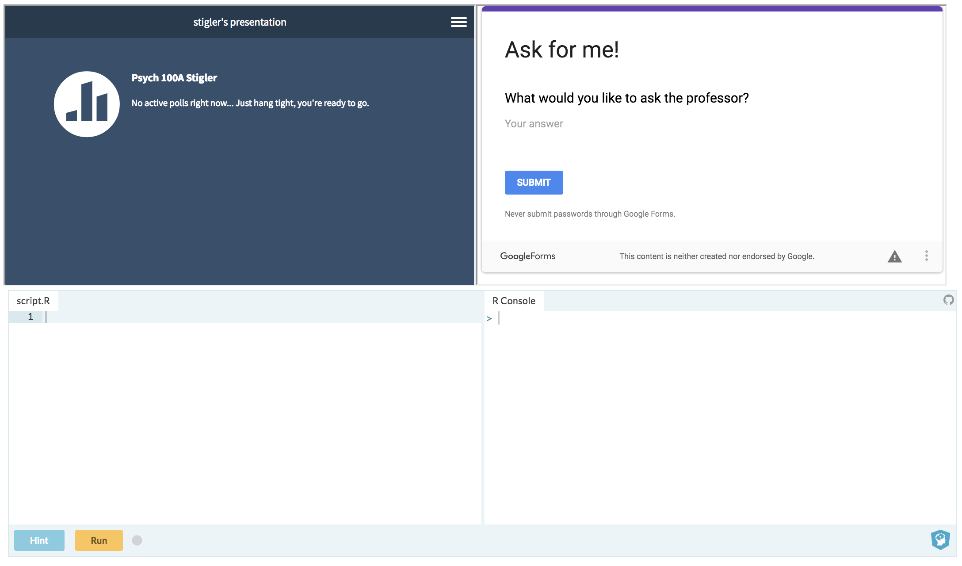
bit.ly/100Aclass
bit.ly/askforme
pollEV.com/stigler
bit.ly/100A-R

Slide 3
Modeling Variation
Psych 100A Spring 2019
Prof. Jim Stigler

Slide 4
Explaining Variation: Working Definition
Knowing someone’s value on the explanatory variable helps you make a better guess about their value on the outcome variable.

Slide 5
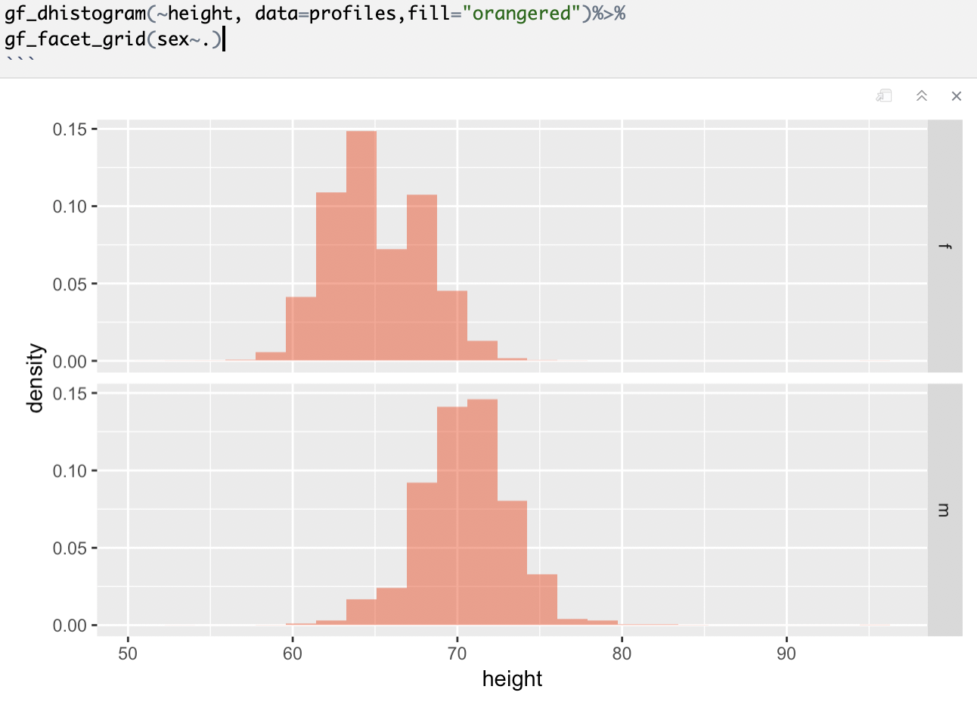
Does sex explain height? In what sense?

Slide 6
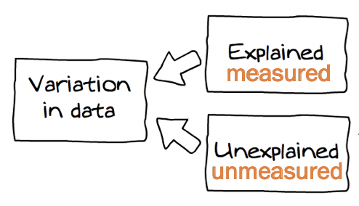
Knowing someone’s value on sex helps you make a better guess about their height.
height = sex + other stuff

Slide 7
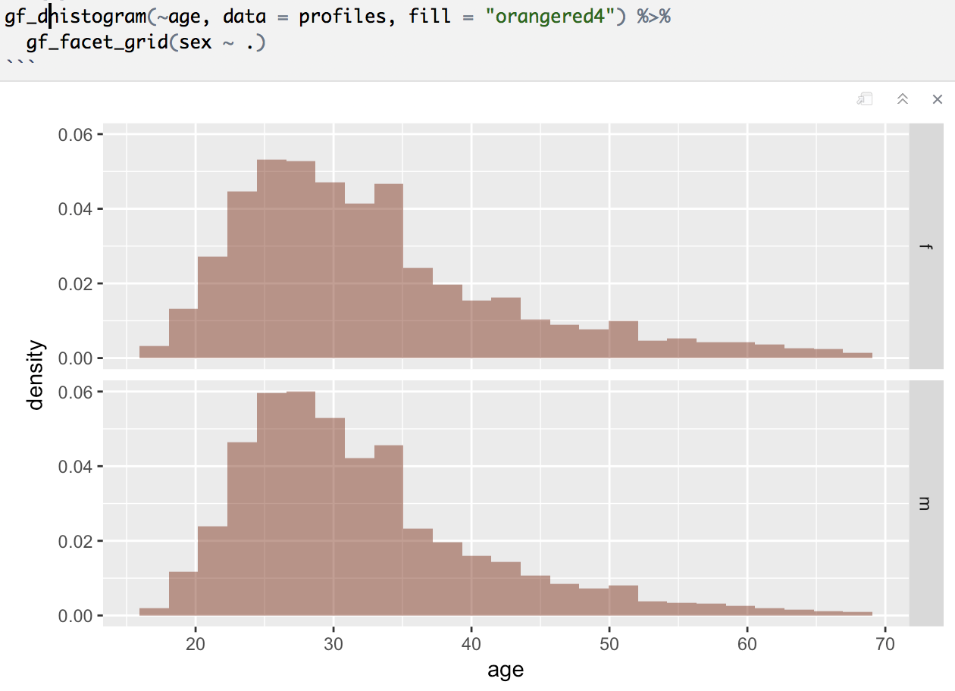

Does sex explain age?

Slide 8
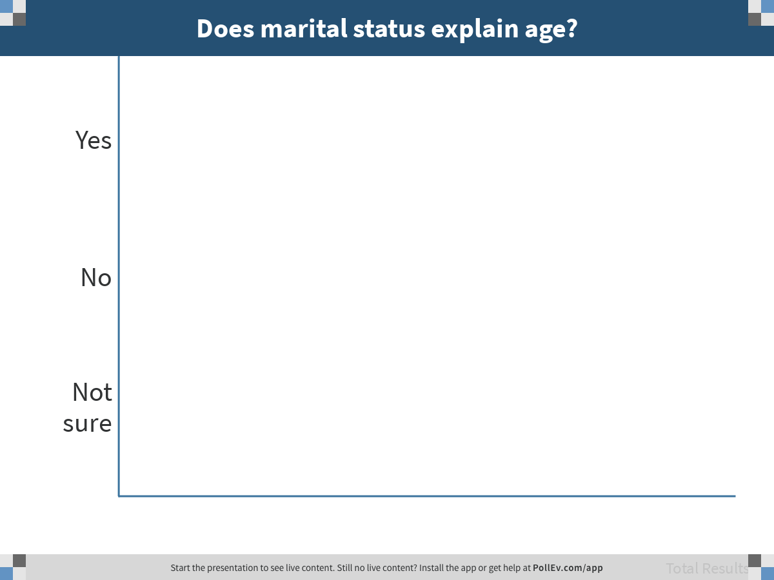
Notes:
Does marital status explain age?
https://www.polleverywhere.com/multiple_choice_polls/EXfLXtrvfkwH9lqeBgiOP

Slide 9
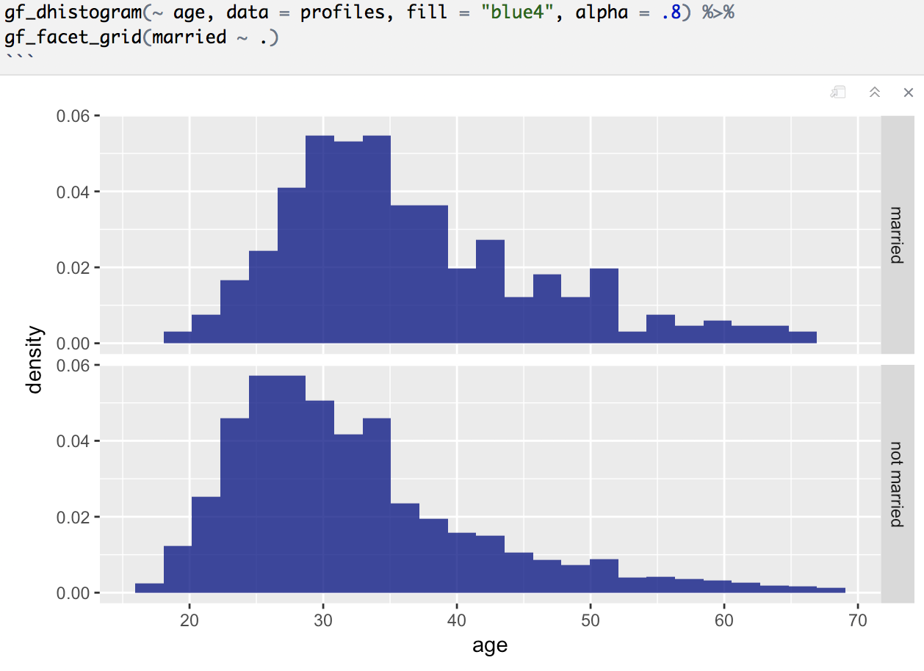
Does marital status explain age?

Slide 10
Notes:
Does marital status explain age?
https://www.polleverywhere.com/multiple_choice_polls/EXfLXtrvfkwH9lqeBgiOP

Slide 11
Does marital status explain more variation than sex?
Age ~ Sex
How much more?
Age ~ Married

Slide 12
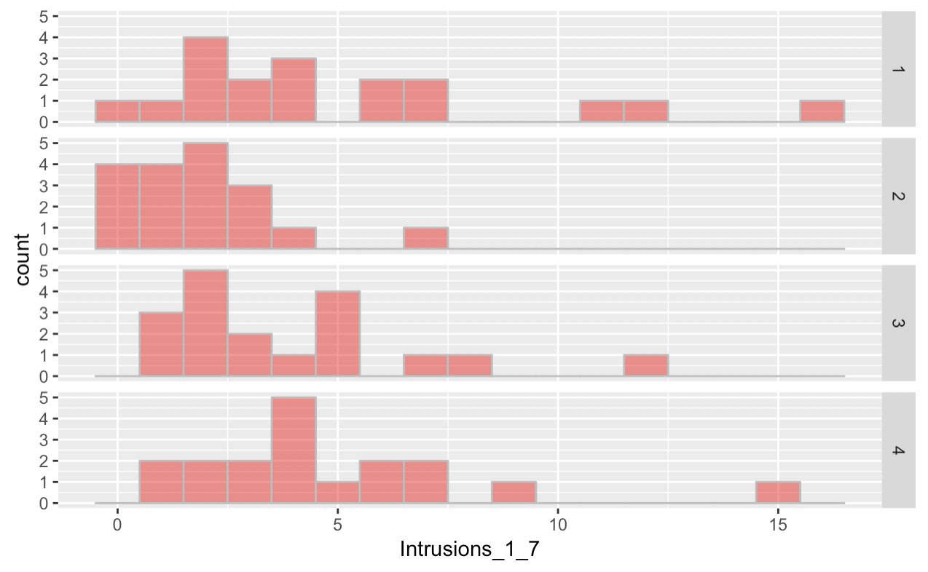
Tetris Data
Does Condition explain number of Intrusions_1_7?

Slide 13
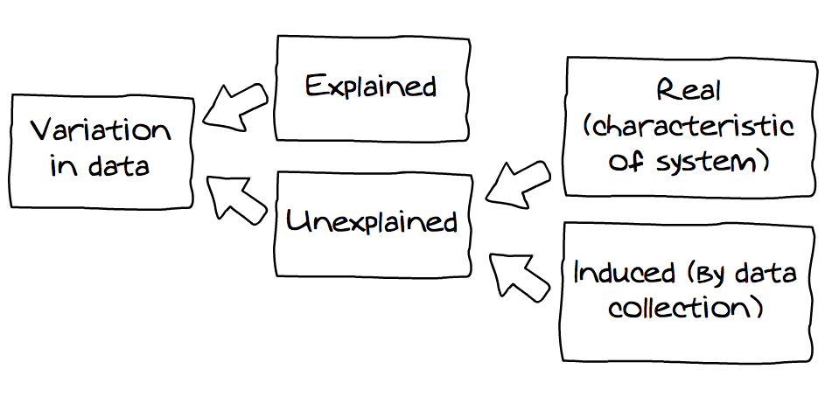
Sources of Variation
Causal
Non-Causal
measured
measured

Slide 14
New data frame: USStates

Slide 15
USStates data frame:
Look at the contents
Create a histogram of FiveVegetables

Slide 16
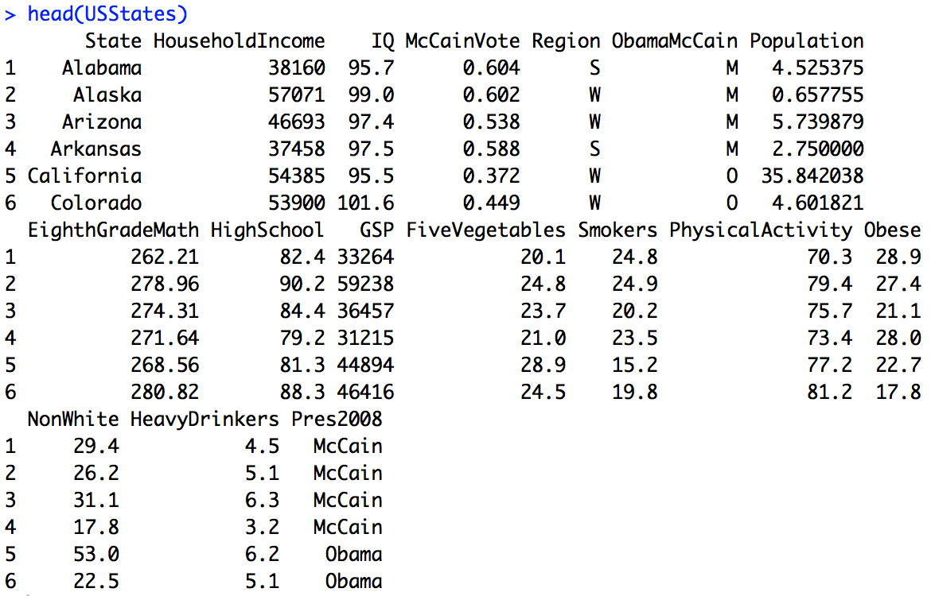
USStates Data Frame

Slide 17
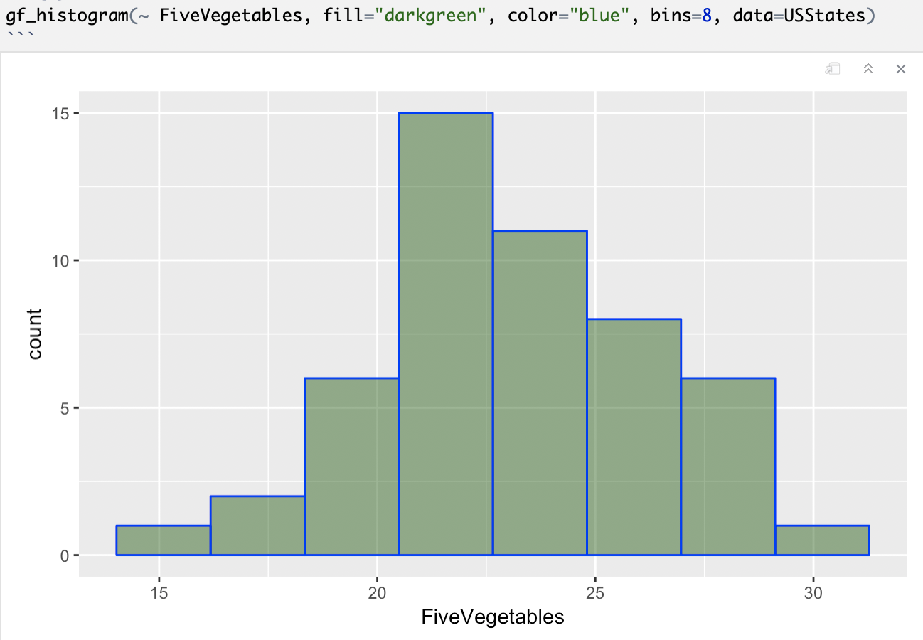
What do the numbers on the y axis mean?

Slide 18
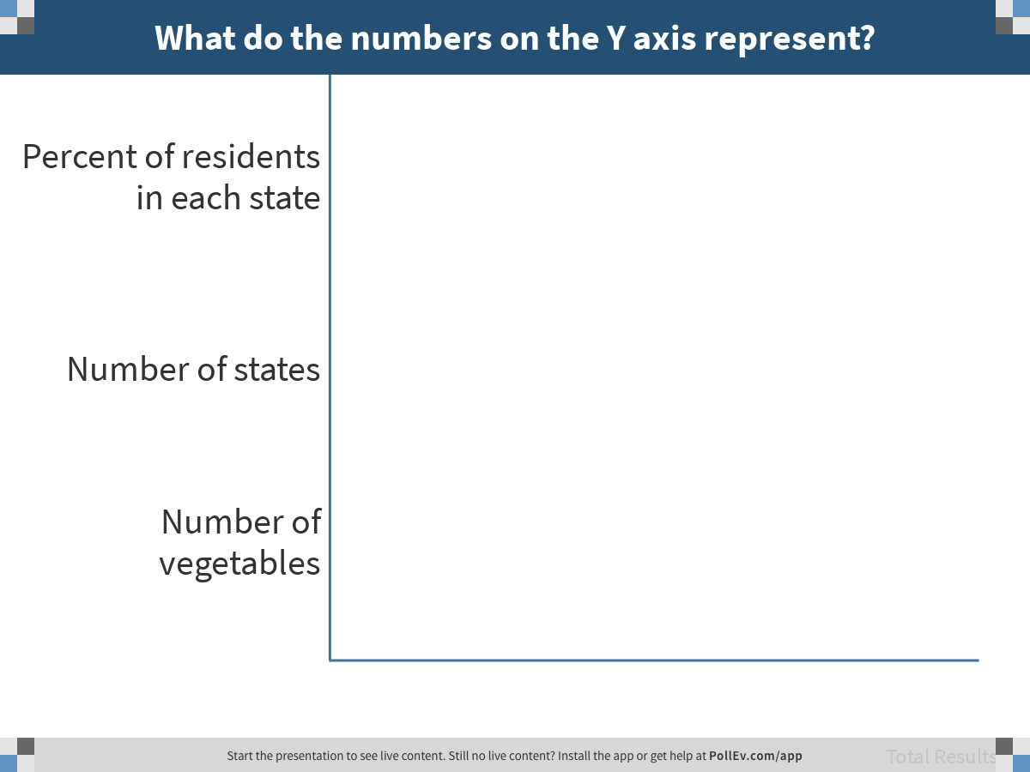
Notes:
What do the numbers on the Y axis represent?
https://www.polleverywhere.com/multiple_choice_polls/K6DBTGyVmDC8AbwbwSZXu

Slide 19
Write some code to visualize the relationship between Pres2008 and FiveVegetables…
FiveVegetables = Pres2008 + Other Stuff

Slide 20
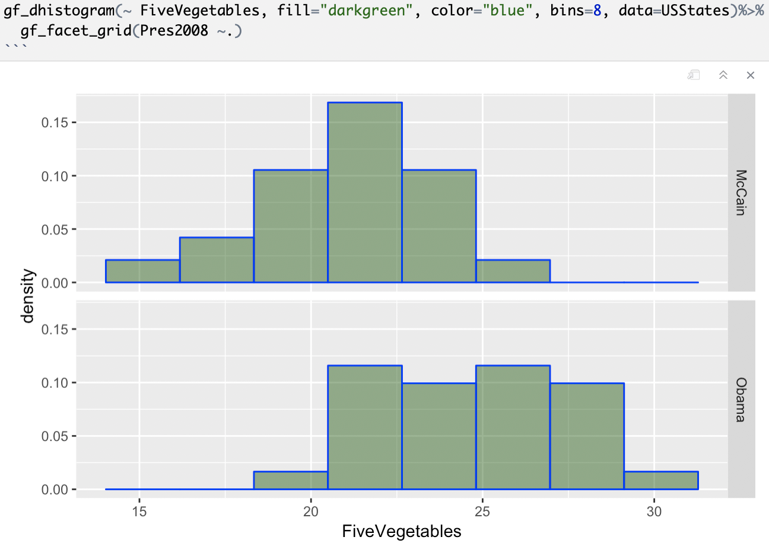

Slide 21
Does Pres2008 explain variation in FiveVegetables in our data?

Slide 22
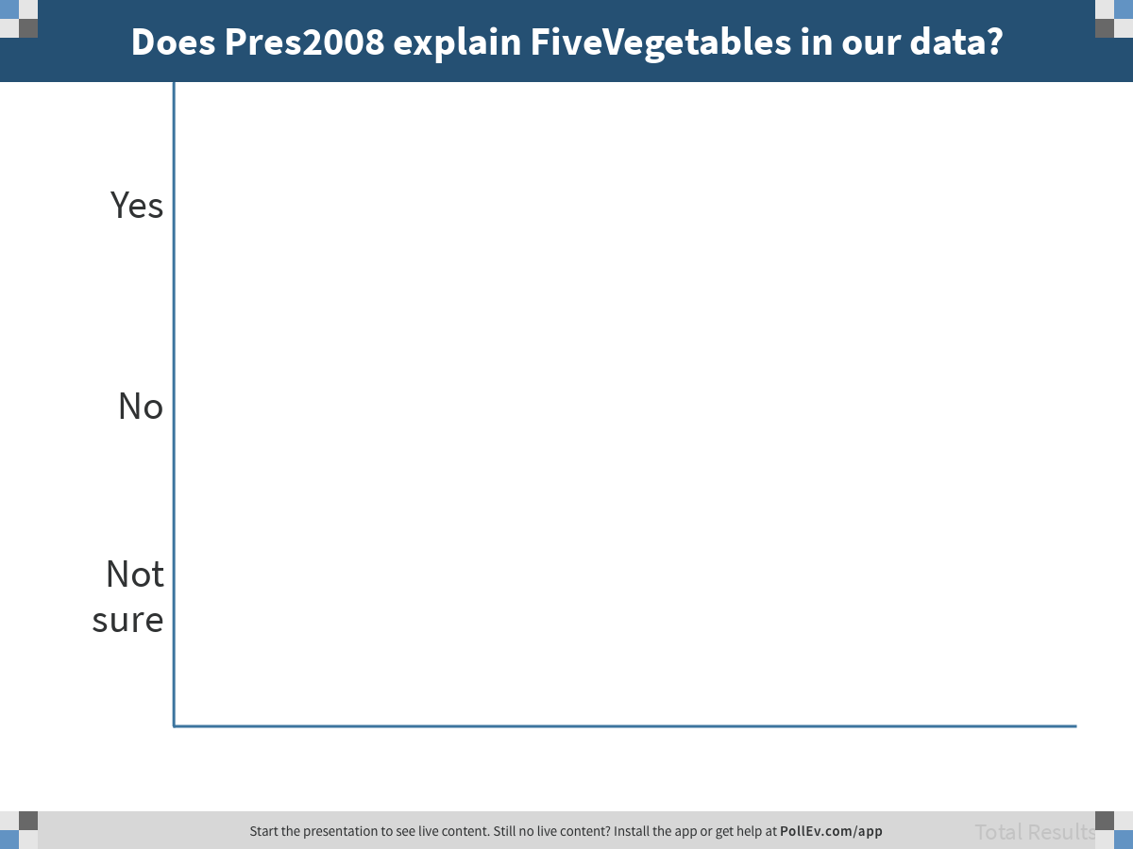
Notes:
Does Pres2008 explain FiveVegetables in our data?
https://www.polleverywhere.com/multiple_choice_polls/HPKQLVle2KAEu5Szrtq2E

Slide 23
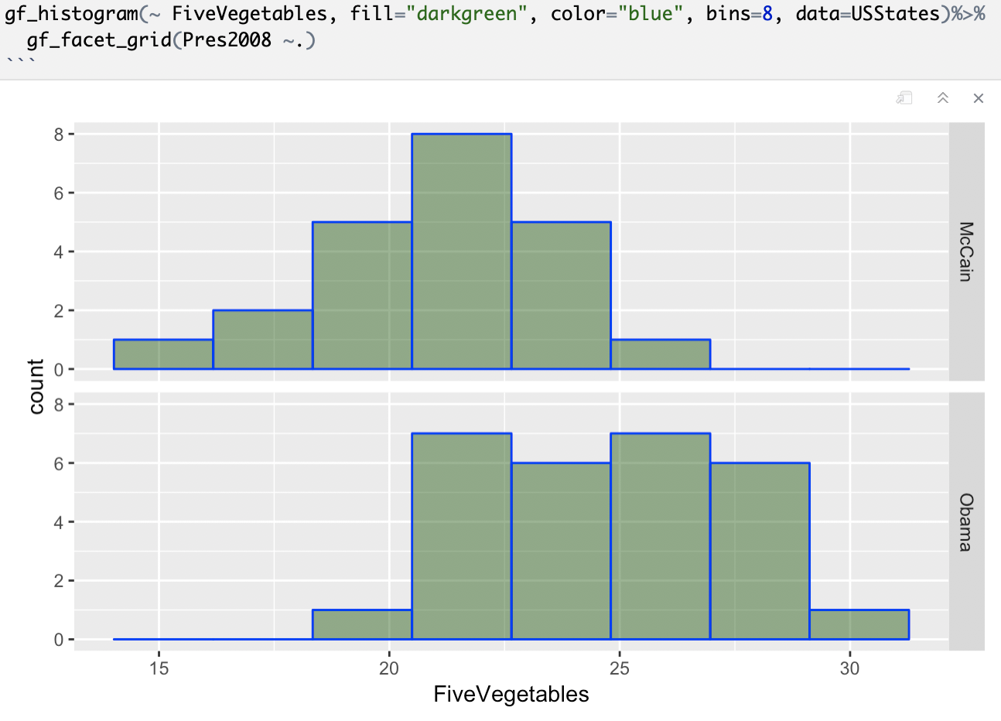
Does Pres2008 explain variation in FiveVegetables in the DGP?

Slide 24
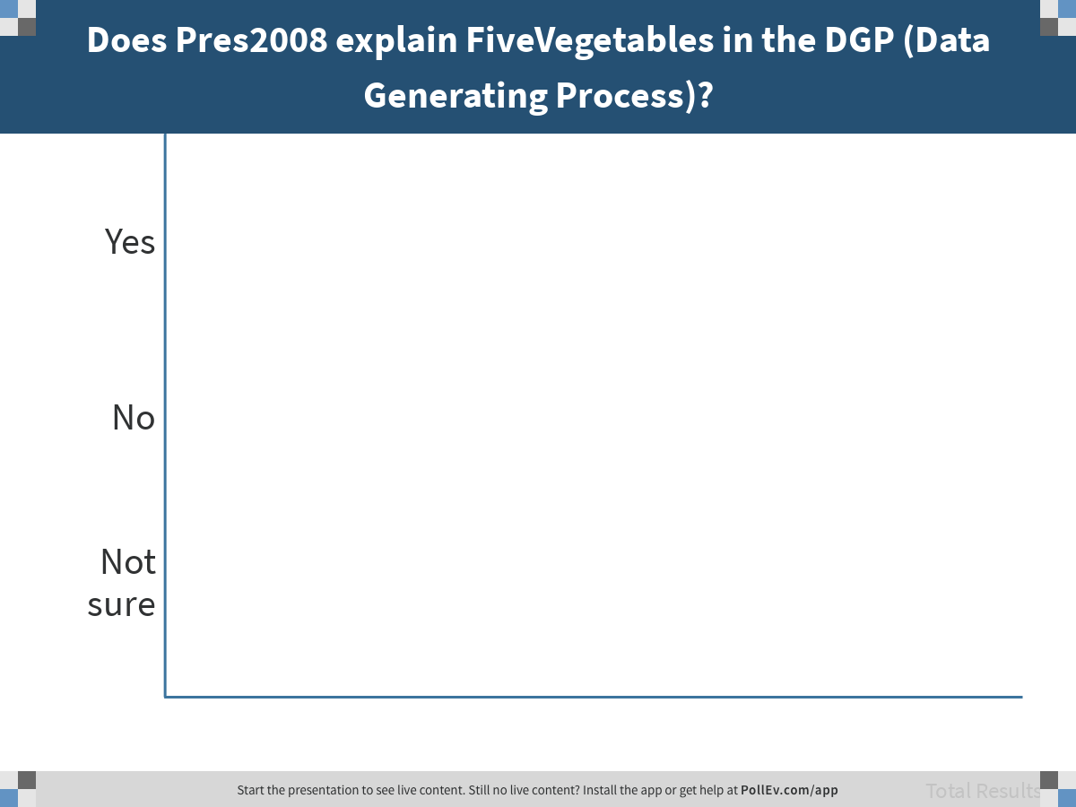
Notes:
Does Pres2008 explain FiveVegetables in the DGP (Data Generating Process)?
https://www.polleverywhere.com/multiple_choice_polls/RTmlVTfAx7tiwLSJD06lz

Slide 25
Explaining Variation
DGP
Population
Sampling
Distribution
Statistical Model
Operates at two levels
Data / Sample

Slide 26
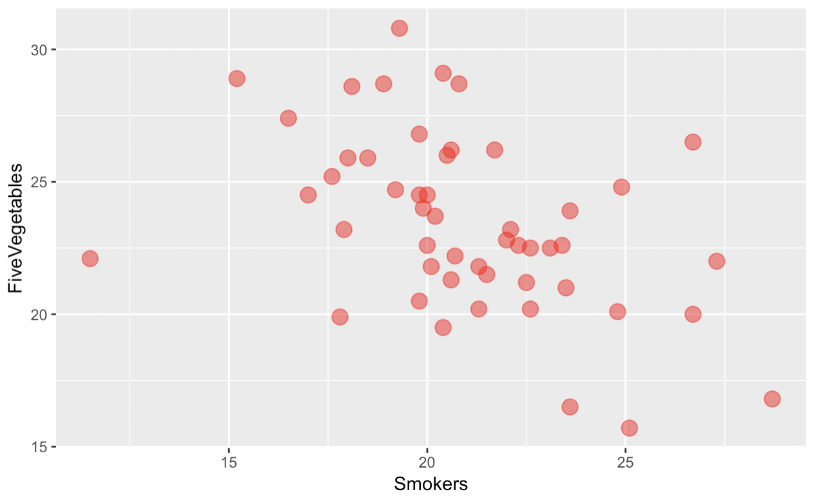
Does Smokers explain variation in FiveVegetables in our data?

Slide 27
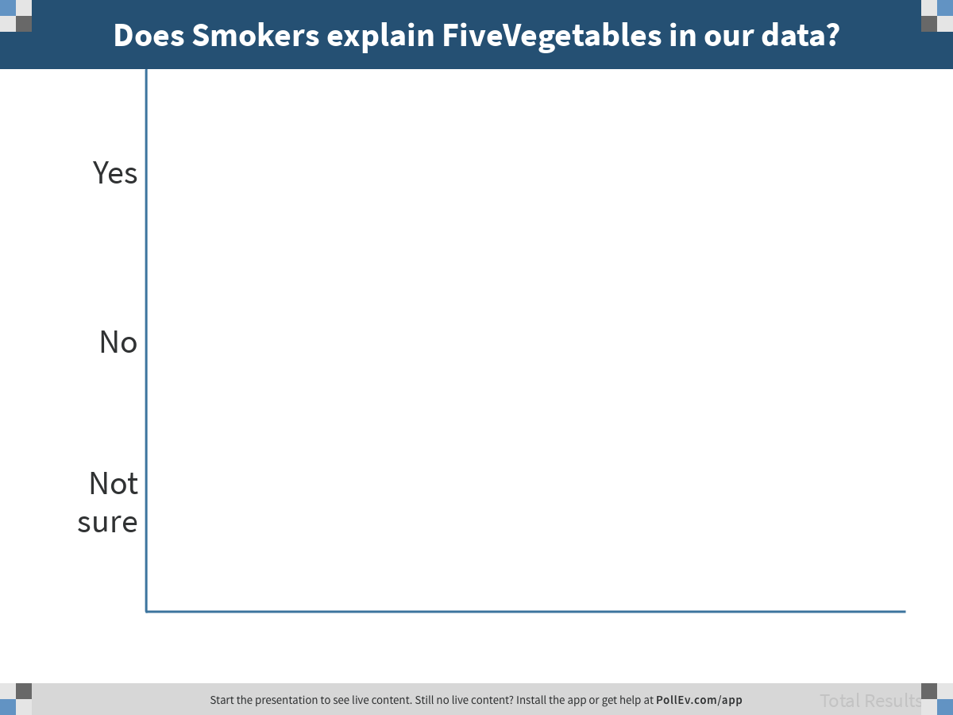
Notes:
Does Smokers explain FiveVegetables in our data?
https://www.polleverywhere.com/multiple_choice_polls/dSHm3FeTEZVJrwVA0ks3s

Slide 28
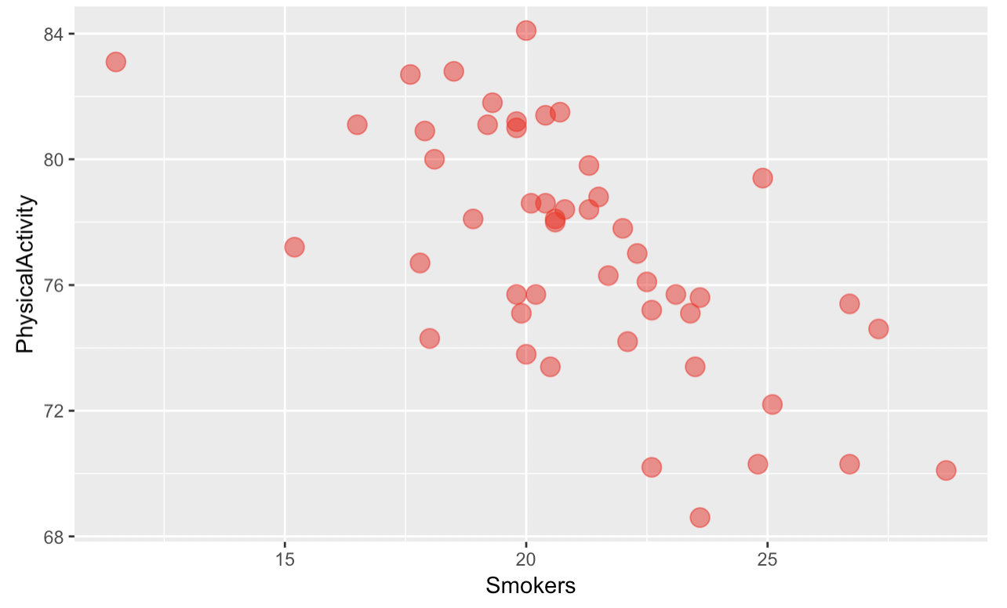
Do people who smoke eat fewer vegetables?

Slide 29
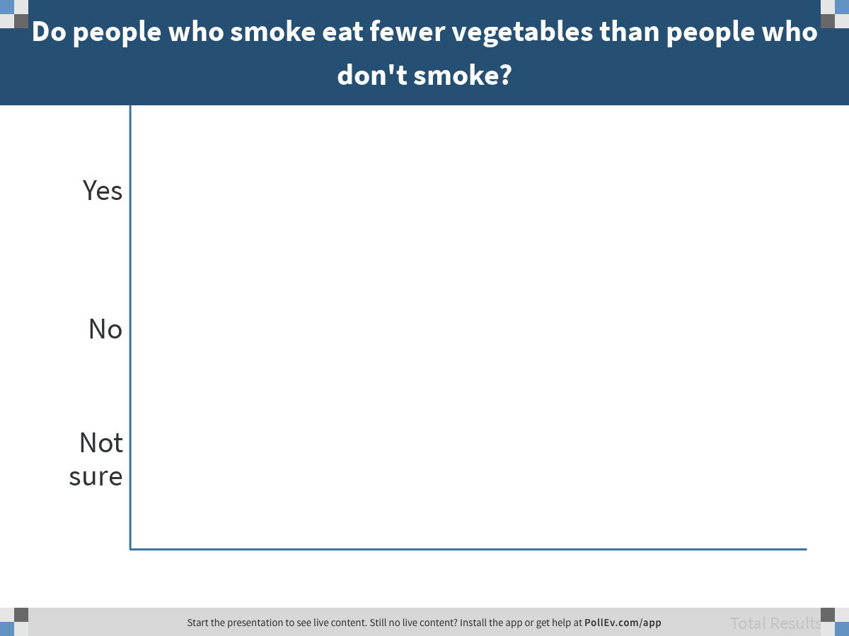
Notes:
Do people who smoke eat fewer vegetables than people who don't smoke?
https://www.polleverywhere.com/multiple_choice_polls/GPeVq64oDjhuQAmRaxFlm

Slide 30
Explaining Variation
Causal
Non-Causal
measured
unmeasured
Explanatory variables can be causal or non-causal.

Slide 31
Statistical Models

Slide 32
FiveVegetables = Other Stuff
FiveVegetables = Pres2008 + Other Stuff

Slide 33
Variation is explained. But how much is explained? Statistical models help us quantify how much.

Slide 34
What is a Model?

Slide 35
What is Error? What is “Best Fit”?

Slide 36
What is a Statistical Model?
FiveVegetables = Pres2008 + Other Stuff

Slide 37
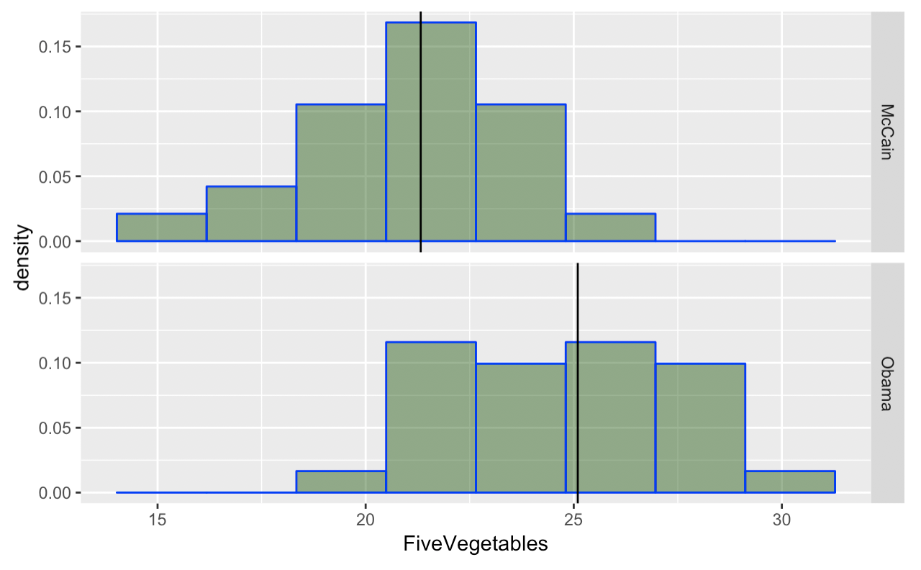
What is a Statistical Model?
M=21.3
M=25.0
FiveVegetables = Pres2008 + Other Stuff
A mathematical function used to generate predictions

Slide 38
What is a Statistical Model?
M=21.3
M=25.0
FiveVegetables = Pres2008 + Other Stuff
What should you predict for this state?

Slide 39
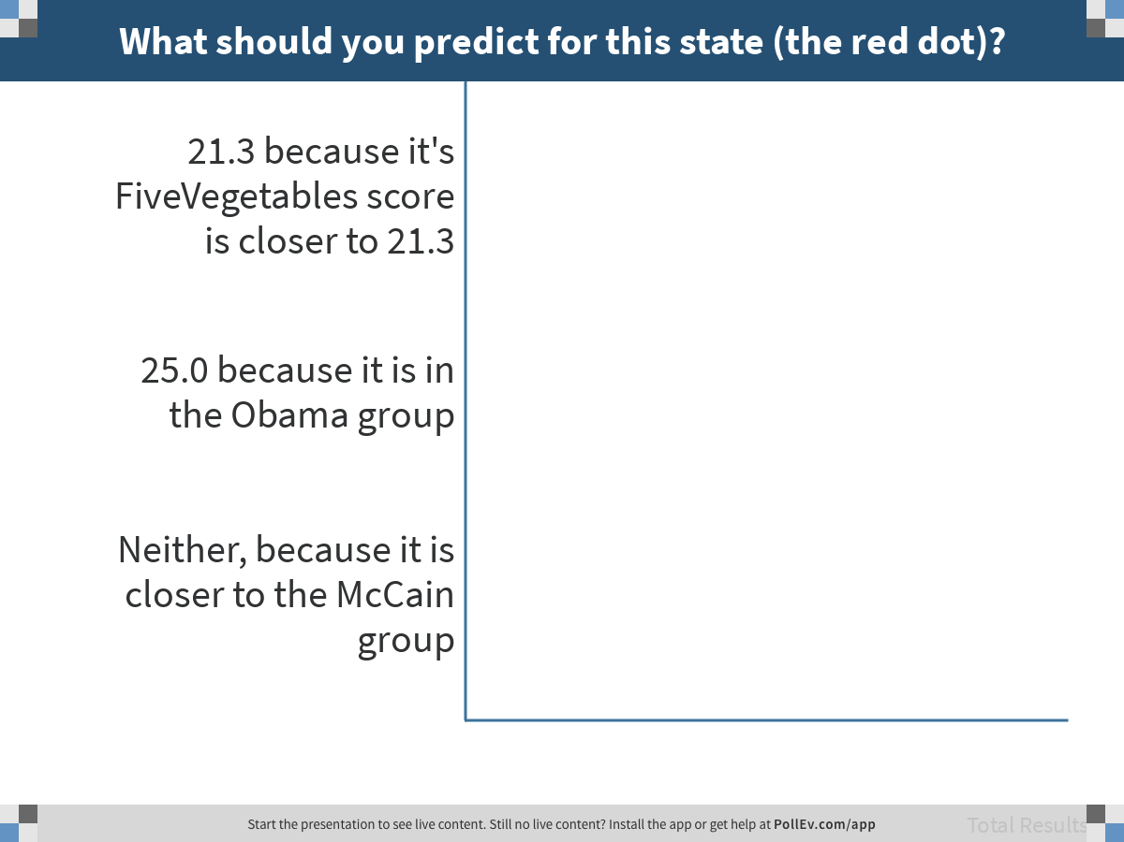
Notes:
What should you predict for this state (the red dot)?
https://www.polleverywhere.com/multiple_choice_polls/E3kWngr11dGQKwJQVWSZ3

Slide 40
What is a Statistical Model?
M=21.3
M=25.0
FiveVegetables = Pres2008 + Other Stuff
A mathematical function used to generate a prediction
How does this improve on our previous definition of explain?

Slide 41
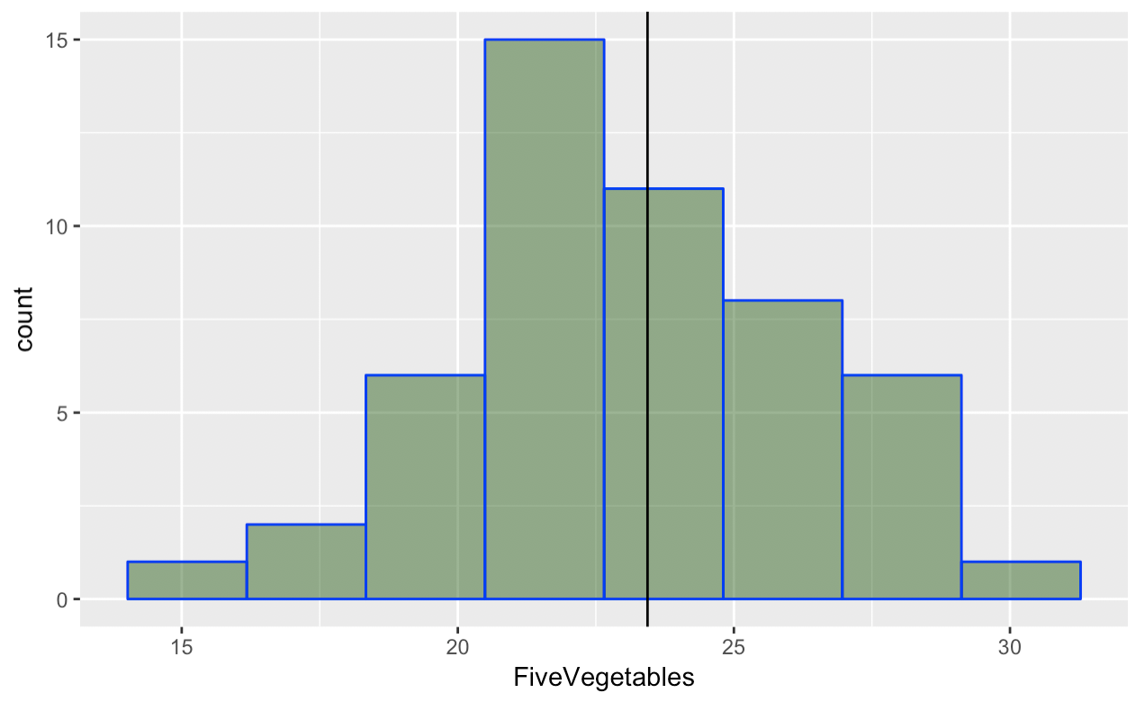
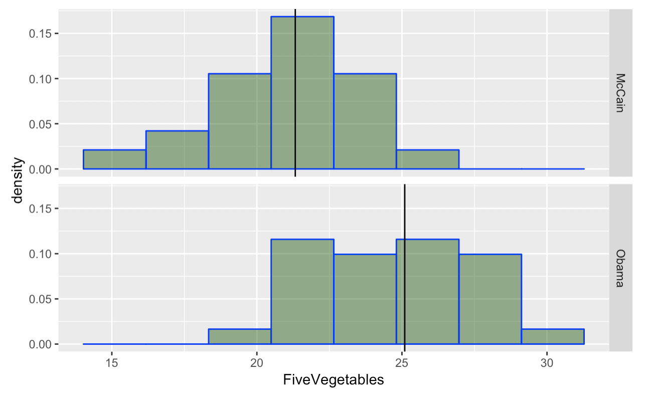
Comparing models
M=23.4
M=21.3
M=25.0
FiveVegetables = mean + other stuff
FiveVegetables = Pres2008 + other stuff

Slide 42
Comparing models
M=21.3
M=23.4
M=25.0
FiveVegetables = mean + other stuff
FiveVegetables = Pres2008 + other stuff
If you use mean as prediction, which model has more error?

Slide 43
The Empty Model

Slide 44
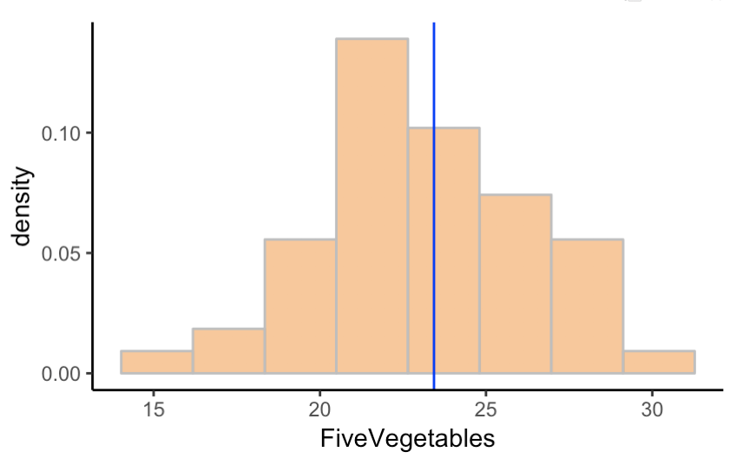
The Empty Model
The simplest statistical model uses a single number to represent a distribution – for example, the mean.

Slide 45
The Empty Model
Error
Error
Error is the part that doesn’t fit within the model.

Slide 46
If you had to pick just one number to represent a distribution…
Notes:
Where does this fit into the California example?

Slide 47
What number? Why useful? What counts as error?
Notes:
What are we modeling? (Center). Useful for predicting next observation. Error is how far away from center; needs to be looked at differently for different kinds of variables.

Slide 48
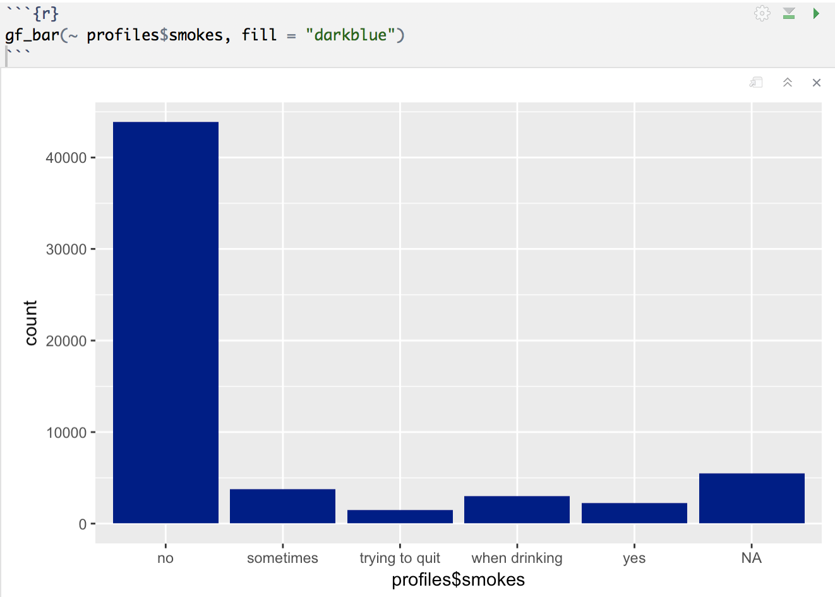
What number? Why useful? What counts as error?

Slide 49
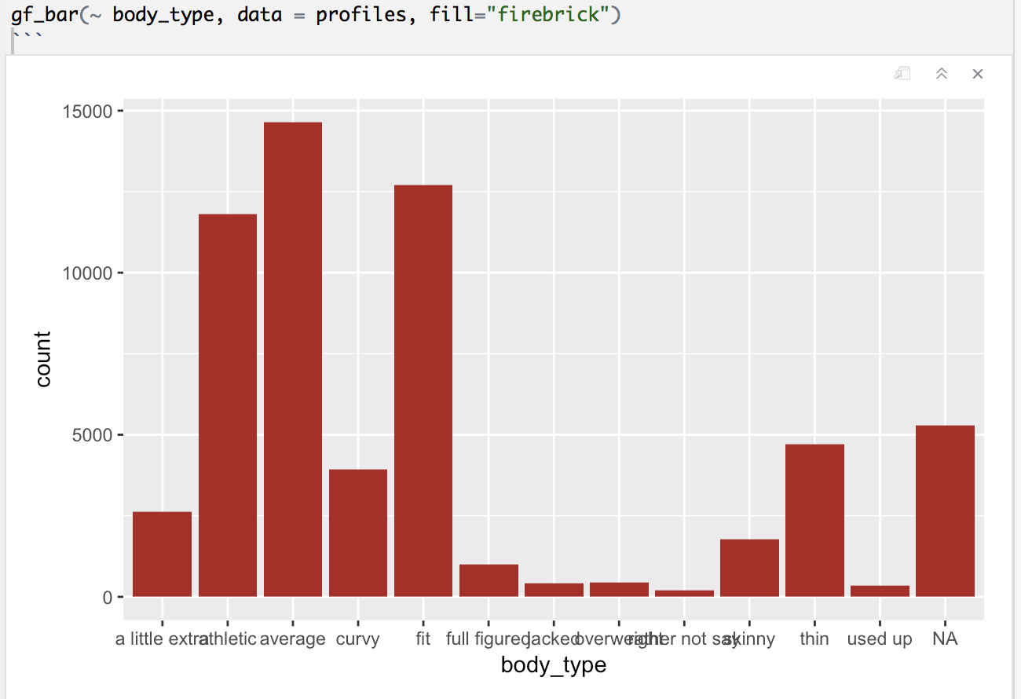
A little extra
Athletic
Average
Curvy
Fit
Full figured
Jacked
Overweight
Rather not say
Skinny
Thin
Used up
NA
What number? Why useful? What counts as error?

Slide 50
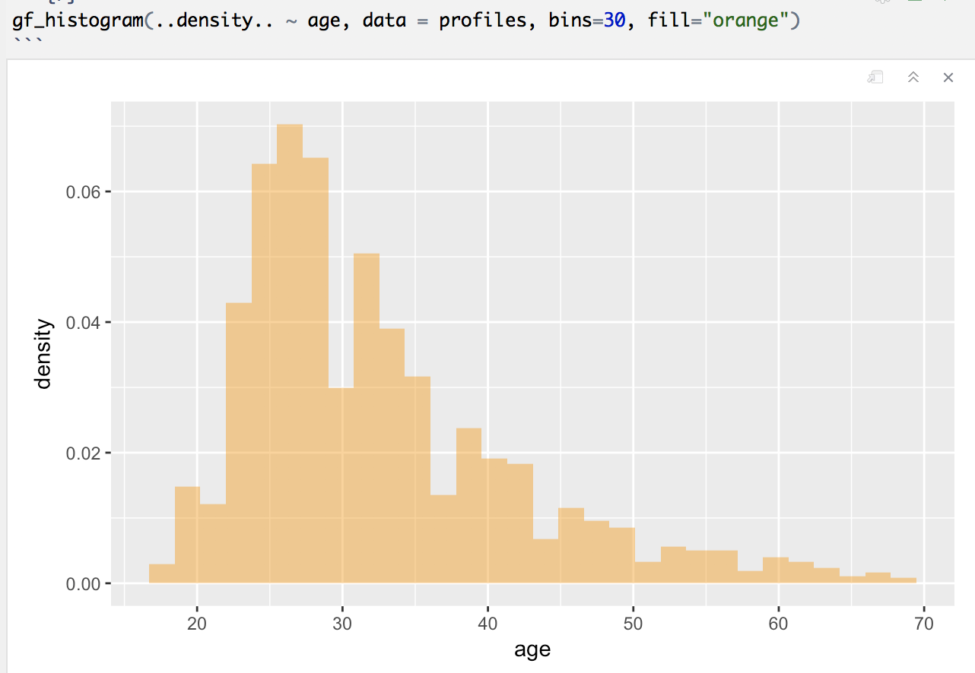
What number? Why useful? What counts as error?

Slide 51
DATA = MODEL + ERROR (literally)
Notes:
Each data point can be partitioned into two parts.

Slide 52
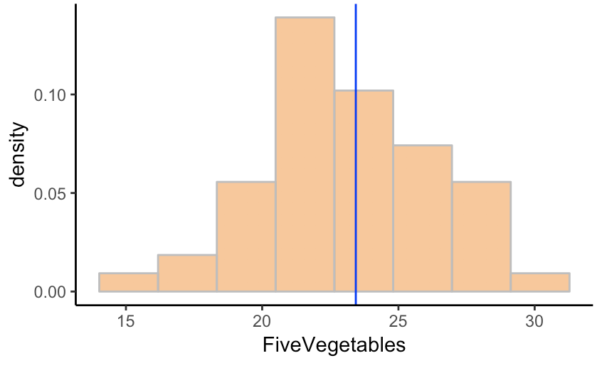
DATA = MODEL + ERROR
Mean = 23
(our simplest
model)
Alabama = 20
Also called residual
Alabama 20
Mean 23
Error
-3
=
+
Every data point can be partitioned into model + error.

Slide 53
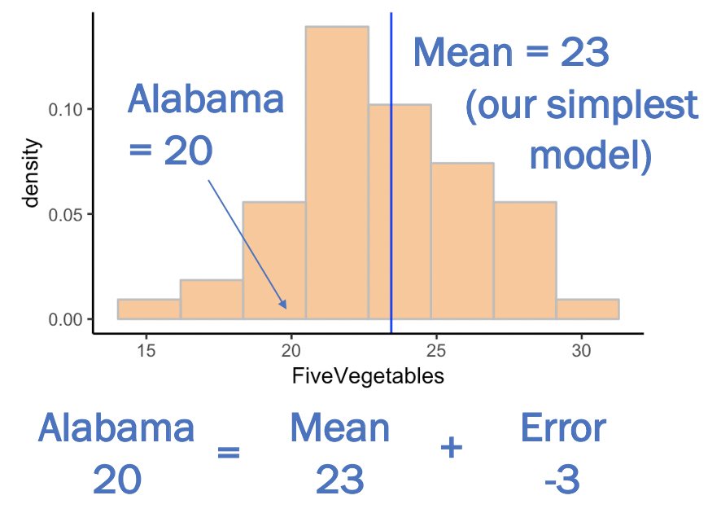
DATA = MODEL + ERROR
FiveVegetables = other stuff
FiveVegetables = mean + other stuff
The empty model, or null model.

Slide 54
The model gives birth to error. The better the model, the lower the error; our goal is to reduce error.
Notes:
Each data point can be partitioned into two parts.

Slide 55
Comparing models
M=21.3
M=23.4
M=25.0
FiveVegetables = mean + other stuff
FiveVegetables = Pres2008 + other stuff
The empty model tells us how much total error there is in the outcome – error we try to reduce by adding explanatory variables.

